Slide 1

AE4010 – Research Methodology
Designing your own research
If we knew what it was we were doing, it would not be called research, would it?
Albert Einstein
Source:
www.einsteinstheorieen.nl/
0. Course Introduction
Prof. Dr. Ricky Curran & Dr. Ir. Gillian Saunders-Smits

Slide 2

Aim of the course
Source: http://www.gnurf.net/v3/portfolio/graduation-thesis-angst.html
This course is primarily a research-driven preparation for the MSc thesis in the final year of the MSc.

Slide 3
Learning Objectives
At the end of the course the student will be able to:
be aware of the expectations of an MSc student
be able to formulate a research question and research aim
be able to set up a research plan for their MOP/Literature Survey/MSc thesis
be able to write a literature review based on the research plan with a view to select appropriate methodologies for their MOP/MSc thesis
based on initial problem, design, set up, run, analyze, manage and evaluate a research project

Slide 4
Fit in MSc Curriculum
Semester 1
Semester 2
Semester 3
Semester 4
MSc courses
MSc Courses
MSc Thesis
research
internship
AE4030 MOP/
AE4020 Lit. Study
Research
Methods

Slide 5
Course Set-up
7 lectures: Mondays 8.45h – 10.30 Lecture Room AE-C,
Every lecture will have a theory & active part
2 Assignments to be handed in by 31 January via Blackboard
Draft Project Plan due Monday 12 December to bring to class

Slide 6
Lecture Overview
Lecture | Subject | Content
1 | Research Design in MSc | stages of a project, research questions, strategy
2 | Research Methods | quantitative & qualitative methods, data collection etc.
3 | Data Analysis | quantitative & qualitative methods using SPSS as an example
4 | Validation & Verification | How to validate & verify your work?
5 | Project Management | How to manage your project and your thesis progress. Project plan peer review
- | Library course | How to carry out a scientific literature review? Differences between review and research
6 | Planning | How to plan, expectations, Gannt Charts
7 | Lit. Review, Scientific Reporting & Presenting Feedback session | Lit. Review assignment discussion, Academic standards, Reproducibility, Reporting styles Closing the loop on course. Feedback and Way Forward Closing the loop on course. Feedback and Way Forward

Slide 7

Book
Designing a Research Project - 2nd edition
by Verschuren & Doorewaard
Eleven International Publishing
ISBN 978-90-5931-572-3
Available via VSV (copies available now) or over the web
For reading during AND after the course!

Slide 8
Assessment
 | Assignment | weight
1 | Write a research plan for MOP/Literature Survey/Thesis. This research plan must contain: aim, research questions, theoretical content, experimental set-up, results outcome & relevance, planning. (Individual assignment) | 60%
2 | Carry out a literature review based on the research plan with a view to select appropriate methodologies for their MOP/MSc thesis and carry out a peer review of another students literature review. (Individual assignment) | 40%
3 | Online Library course | completed

Slide 9
Deadlines 2nd Period
Hand in date: 31 January 2012
Grade intended by: 20 April 2012
No hand in possible after deadline! – Redo next semester!
All work must be handed in via Blackboard and will be checked via Safe Assign.

Slide 10
Blackboard
Will be used for:
Announcements
Lecture slides
Hand-outs
Handing in Assignments (via Safe Assign)
Additional information such as recommended literature etc.

Slide 11
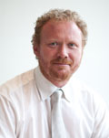
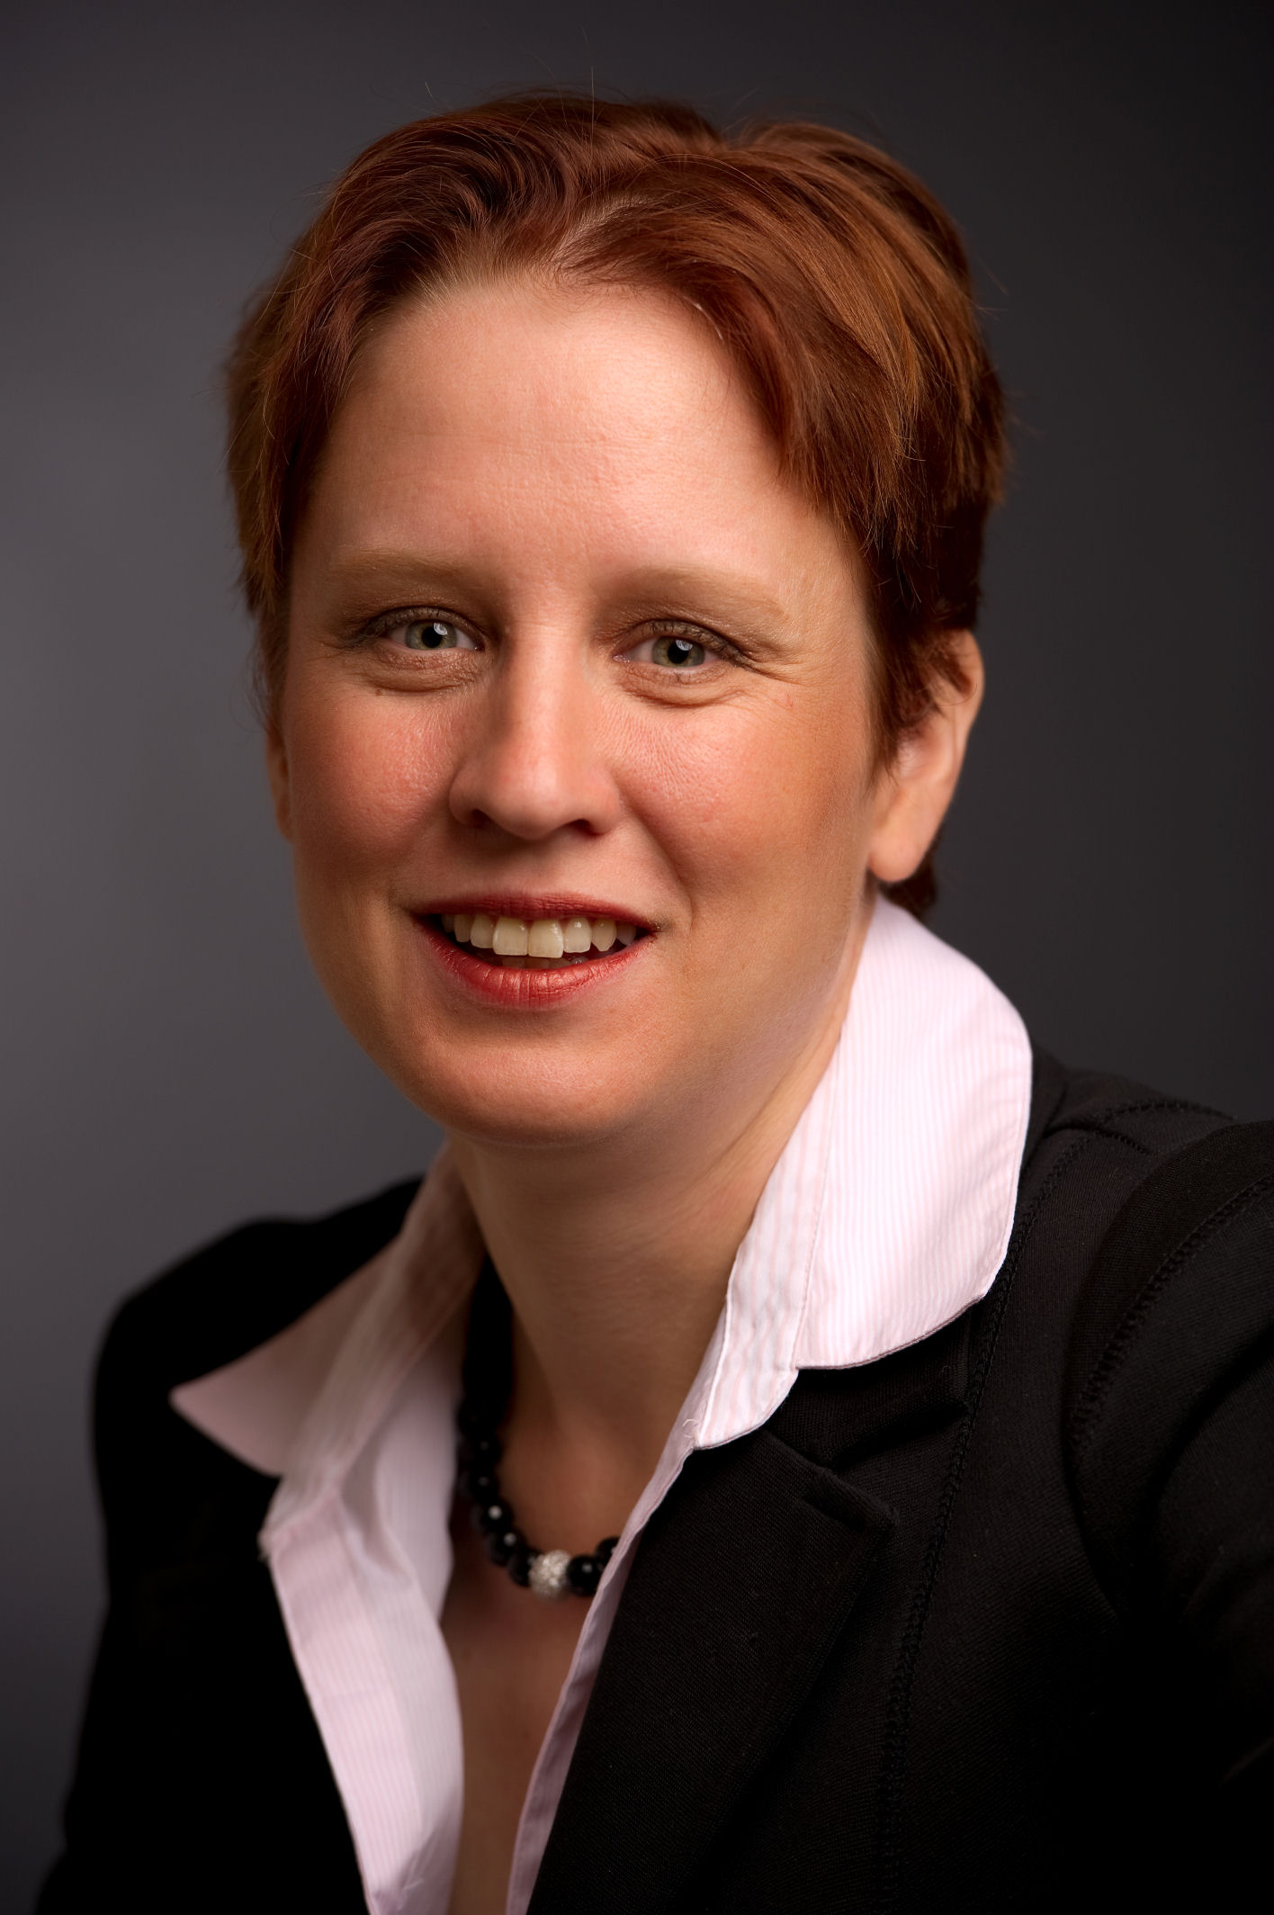
Staff Contact Details
Prof. Dr. Ricky Curran:
r.curran@tudelft.nl
with Subject: AE4-400: state topic
Dr. Ir. Gillian Saunders-Smits:
    g.n.saunders@tudelft.nl
    Absent on Wednesdays
    Twitter: @Mrs_AeroLec
    (feedback during class appreciated)

Slide 12
First Assignment: Research Plan
Write a research plan on a topic relevant to your chosen Master Track and Profile. Try linking it in to your Master Orientation Project or your Literature Survey assignment (or even your thesis). See template on Blackboard for more detailed description.
Requirements:
  Use the template on Blackboard.
  Max. no of pages: 10
  Font: 10pt minimum

Slide 13
Second Assignment: Literature Review
Write a short review paper on a topic relevant to your chosen Master Track and Profile based on a minimum of 15 academic quality references Try linking it in to your Master Orientation Project or your Literature Survey assignment (or even your thesis). See template on Blackboard for more detailed description.
Requirements:
  Use the template on Blackboard.
  No of pages: 4-7
  Font: 10pt minimum
  Minimum number of academic references: 15

Slide 14
To do by next week:
Buy book
Start Reading Chapters 1-4
Acquire a topic for your Research Plan and make a start with your draft!
For next lecture: formulate a research question and some research objectives

Slide 15
Your expectations: What would you like to learn in this course?

Slide 16
Questionnaire
Q1: Why did you choose to study aerospace engineering?
Q2: Have you obtained your BSc in Aerospace Engineering from TU Delft?
Q3: Which Master Track & Profile did you choose?
Q4: Please indicate what career/employment type would you like?

